Slide 1

DIGITAL SIGNAL PROCESSING Chapter 8
Information Theory and Coding
EEE DSP Teaching Team
Official (Open), Non-sensitive
Notes:
Welcome to chapter 8, information theory and coding. There are two parts. The first part is information theory and the second part is source coding, in particular a very useful technique call Huffman coding. For Information Theory, we will define what is information and how to calculate source entropy.
The ultimate goal of any communication system is to transmit over a channel, the information originating from a source in one location, to the destination in another location as speedily and reliable as possible. A communication system will comprise of the transmitter, channel and receiver. At the transmitter side, we will have the source generator that will send information to the source encoder, channel encoder and modulator. We will concentrate on the source encoder. The purpose of the source encoder is to remove or reduce the redundancy in the source output so as to give an efficient representation of the message information given by the source by using less bits. In other words, we can treat source encoding as data compression.
Huffman coding a useful technique of source coding will be taught in this chapter.

Slide 2
Understand the Information Theory and Coding
At the end of this chapter, students should:
Understand basic concepts of information theory.
Understand the need for source coding for efficient and reliable digital communication.
Official (Open), Non-sensitive
Notes:
In Chapter 8, we will go through the basic concepts of information theory and the need for source coding for efficient and reliable digital communication.
We will try to understand what is information? Can we measure it? And to what extend we measure it? The information can be discrete symbols, one dimensional array of digital audio signals, two dimensional image signals and three dimensional video signals.

Slide 3

8.1 Introduction to Information Theory
Information content of a message depends on the probability of the event associated with the message.
The lower the probability of occurrence of the event, the higher is the information content of the message.
The sun will rise from the east tomorrow: → 100% probability → Zero information content
Singapore will have an earthquake next week: → Very low probability → Very high information content
In digital communications, information content is measured on a per symbol basis.
Official (Open), Non-sensitive

Slide 4
8.1 Introduction to Information Theory
Average Information content of symbols
Suppose a source emits one of M symbols, S₁, S₂, S₃, ... S_{M}. Let P₁, P₂, P₃, ... P_{M} be the probabilities of occurrence of the M symbols, respectively.
Information content, I of the symbol S_{i} is defined as:
I(S_{i}) = log₂ ( 1/P_{i} ) bits where P_{i} is the probability of occurrence of the symbol, S_{i}
E.g I(S₃) = log₂ ( 1/P₃ ) bits
From the formula, symbol less likely to occur provide more information.
Official (Open), Non-sensitive

Slide 5
Quiz
A fair die has six faces marked 1, 2,3,4,5 and 6 with the same probability 1/6 for all the faces. Find the information content associated with the single throw of the die
a) 2.59 bits
b) 1.59 bits
c) 0.59 bits
d) 0 bit
Official (Open), Non-sensitive
Notes:
Answer a

Slide 6
Quiz
A coin has 2 faces marked head, H and tail, T with the same probability 1/2 for each faces. Find the information content associated with the single throw of the coin.
a) 2 bits
b) 1 bit
c) 0.5 bit
d) 0 bit
Official (Open), Non-sensitive
Notes:
Answer b

Slide 7


8.1 Introduction to Information Theory
The average information content of a N-symbol message is given by:
I (total)/ N = P_{i} log₂ (1/P_{i})
= ‑ P_{i} log₂ P_{i} bits/symbol (6.4)
= Source entropy, H
The average rate of information going through a channel is:
Average rate of information or Information Rate = H x r_{s}
where r_{s} is the symbol rate.
I(total) =Total information content in the message

Slide 8
Quiz
A source emits two symbols, a and b with probabilities P_{a} = 0.25 and P_{b} = 0.75. What is the source entropy?
a) 1 bit/symbol
b) 0.5 bit/symbol
c) 0.25 bit/symbol
d) 0.8112 bit/symbol
Official (Open), Non-sensitive
Notes:
Answer d

Slide 9
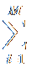
8.1 Introduction to Information Theory
Example 8.2
A discrete source emits one of five symbols once every millisecond. The symbol probabilities are P₁ = 1/2; P₂ = 1/4; P₃ = 1/8; P₄ = 1/16; P₅ = 1/16. Find the source entropy and information rate.
Solution
Symbol rate r_{s} = 1000 symbols/sec
Entropy H = P_{i} log₂ 1/P_{i} where M = 5
H = 1/2 log₂ 2 + 1/4 log₂ 4 + 1/8 log₂ 8 + 1/16 log₂ 16 + 1/16 log₂ 16
H = 1.875 bits/symbol
Information rate = H x r_{s} = 1 875 bits/sec
Note:log_{a} b =

Slide 10

Image Entropy
Gray Image
Entropy value ?

Slide 11
8.2 SOURCE CODING
0, 01,11
a
b
c
Discrete
Information
Source
Source
Encoder
Channel
Encoder
Modulator
d
Electrical
Communication
Channel
Sequence
of
Symbols
Binary
Stream
Digitally
encoded
carrier
(Analog)
+
+
Σ
Noise
Destination
Source
Decoder
Channel
Decoder
Demodulator
f
i
h
g

Slide 12
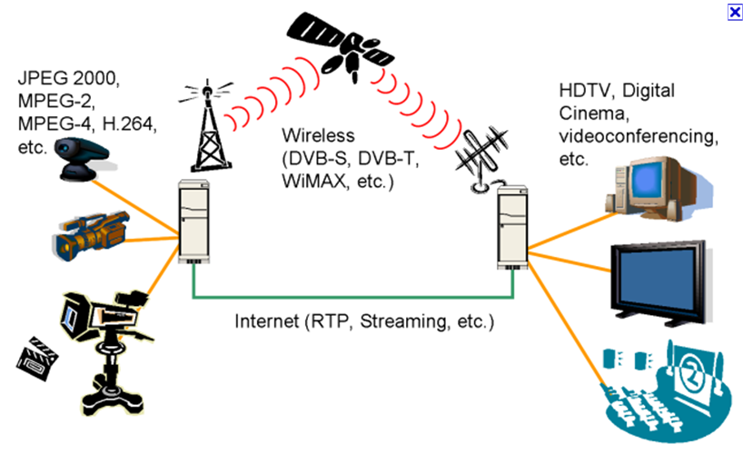
8.2 SOURCE CODING
Source coding converts symbols into binary bits reducing any redundant information.
Purpose of source coding : reduce the bandwidth/transmission time and storage capacity.
A common source coding method: variable-length coding (instead of fixed-length coding).
Symbols with higher probability are coded with shorter codewords thus using less bits on average.

Slide 13
8.2 SOURCE CODING
Properties of codes
For a code to be useful it must have the following properties:
uniquely decodable property
prefix-free property
A code is a mapping of symbols into codewords (binary bits)
Symbol | Code A | Code B
a | 00 | 00
b | 11 | 10
c | 111 | 110

Slide 14
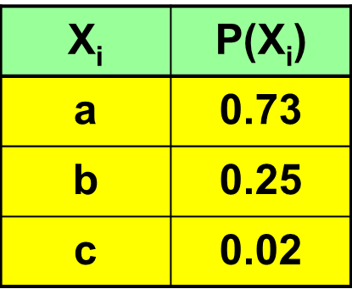
8.2 SOURCE CODING
Table 8.1 Three-symbol alphabet
Properties
uniquely decodable
prefix-free
Various binary codes can be designed to represent the 3-symbol source:
Symbol | Code 1 | Code 2 | Code 3 | Code 4 | Code 5 | Code 6
a | 00 | 00 | 0 | 1 | 1 | 1
b | 00 | 01 | 1 | 10 | 00 | 01
c | 11 | 10 | 11 | 100 | 01 | 11
codewords
Table 8.2 Six possible binary codes for the 3-symbol source

Slide 15
8.2 SOURCE CODING
Uniquely Decodeable Property
Allow remap to the original symbol alphabet without ambiguity.
Code 1 is not uniquely decodable as the symbol a and b are assigned the same binary codeword.
First requirement of a useful code is that each symbol be assigned a unique binary codeword.
Codes 3 and 6 have unique binary codewords. Problem occurs when these codewords are transmitted serially.

Slide 16
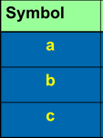
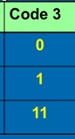
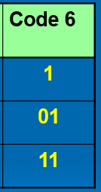
8.2 SOURCE CODING
E.g, In code 3, try to decode the received binary pattern: 1 0 1 1 1
Answers:
1 / 0 / 1 / 1 / 1 ------ b, a, b, b, b
1 / 0 / 1 / 1 1 ------ b, a, b, c
1 / 0 / 1 1 / 1 ------ b, a, c, b
Hence code 3 is not uniquely decodable even though each symbol has a unique codeword.
Code 6 has the same problem and is also not uniquely decodable

Slide 17
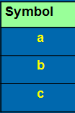
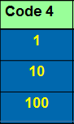
8.2 SOURCE CODING
A solution – Codes with Prefix-Free Property
Condition for uniquely decodable code is that no codeword be the prefix of any other codeword - prefix-free codes.
Prefix-free codes have another feature – they are also instantaneously decodable or prefix code.
An instantaneously decodable code is one for which the boundary of the present codeword can be identified by the end of the present codeword rather than by the beginning of the next codeword.
Code 4 is not instantaneously decodable.
1
→ a ?
1 0
→ b ?
1 0
0
→ c
1 0
1
→ b a

Slide 18
8.2 SOURCE CODING
Code 5 is prefix-free : both uniquely decodeable and instantaneously decodable – best code.
Symbol | Code 1 | Code 2 | Code 3 | Code 4 | Code 5 | Code 6
a | 00 | 00 | 0 | 1 | 1 | 1
b | 00 | 01 | 1 | 10 | 00 | 01
c | 11 | 10 | 11 | 100 | 01 | 11
Table 6.2 Six possible binary codes for the 3-symbol source

Slide 19
6.2 SOURCE CODING
Code Length and Source Entropy
The average code length of a code is denoted by . It is computed as:
(7.5)
Source entropy, H has been defined as the average information per symbol.
Source entropy, H also represents the minimum possible average bit length achievable by a variable-length code – ideal for a source.
n_{i} = number of bits in the codeword
P(X_{i}) = probability of occurrence

Slide 20
Various codes to represent the 3-symbol source:
8.2 SOURCE CODING
Table 8.1 Three-symbol alphabet
Symbol | Code 1 | Code 2 | Code 3 | Code 4 | Code 5 | Code 6
a | 00 | 00 | 0 | 1 | 1 | 1
b | 00 | 01 | 1 | 10 | 00 | 01
c | 11 | 10 | 11 | 100 | 01 | 11
E.g. Average bit length for code 5

Slide 21
8.2 SOURCE CODING
Huffman Coding
Prefix-free variable-length code.
Can achieve the shortest average code length.
Source Entropy, H is the ideal average code length.
The Huffman code is generated as part of a tree forming process: - Fig. 8.3
List the input symbols and their probabilities in decreasing order of occurrence
Each entry corresponds to the branch of a tree.
The 2 entries with the lowest probabilities are merged to form a new branch with their composite probability.

Slide 22
8.2 SOURCE CODING
Figure 8.3 Huffman coding tree for a six-symbol set
Symbols
a
b
c
d
e
f
0.4 0.4 0.4 0.4 0.6
0.2 0.2 0.2 0.4
0.4
1.0
0.1 0.2 0.2 0.2
0.6
0.1 0.1 0.2
0.4
0.1 0.1
0.2
0.2
0.1

Slide 23
8.2 SOURCE CODING
After every merging, the new branch and the remaining branches are reordered to preserve the descending probability of occurrence.
After forming the tree, each branch is labelled with a binary 1 or 0. If 1 is to be sent as often as possible, we label the branch going up with a 1 and the branch going down with a 0.
The path from the base of the tree to the symbol contains the codeword for that symbol.

Slide 24
8.2 SOURCE CODING
LSB
MSB
Figure 6.3 Huffman coding tree for a six-symbol set
a
b
c
d
e
f
0.4 0.4 0.4 0.4 0.6
1
0
0.2 0.2 0.2 0.4
0.4
1.0
1
0
0.1 0.2 0.2 0.2
0.6
1
0
0.1 0.1 0.2
0.4
1
0
0.1 0.1
0.2
1
0
0.2
0.1

Slide 25
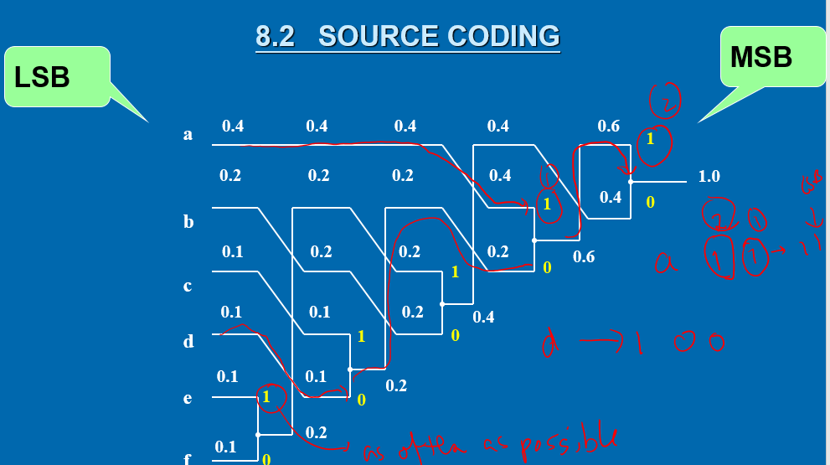
Quiz
What is codeword for a?
a) 11
b) 00
c) 101
d) 100
Notes:
Answer a

Slide 26
Quiz
What is codeword for b?
a) 11
b) 00
c) 101
d) 100
Notes:
Answer b

Slide 27
Quiz
What is codeword for c?
a) 11
b) 00
c) 100
d) 101
Notes:
Answer d

Slide 28
Quiz
What is codeword for d?
a) 11
b) 00
c) 101
d) 100
Notes:
Answer c

Slide 29
8.2 SOURCE CODING
Table 8.3 below lists the resulting codewords.
X_{i} | P(X_{i}) | Code-word | n_{i} | n_{i}P(X_{i})
a | 0.4 | 11 | 2 | 0.8
b | 0.2 | 00 | 2 | 0.4
c | 0.1 | 101 | 3 | 0.3
d | 0.1 | 100 | 3 | 0.3
e | 0.1 | 011 | 3 | 0.3
f | 0.1 | 010 | 3 | 0.3
 |  |  |  | =2.4
where i = 1, 2, ..., 6

Slide 30
8.2 SOURCE CODING
The average code length, for this alphabet is 2.4 i.e. on the average 240 bits are when transmitting 100 symbols.
Note: A fixed-length code would require a code length of 3 bits per symbol.
Compression ratio = average number of bits per symbol before compression ÷average number of bits per symbol after compression.
For this code, compression ratio = 3.0/2.4 = 1.25
Code efficiency = (entropy ÷ average code length) x 100%
Entropy for this code is 2.32. Hence this code achieve 2.32/2.4 or 96.4% of the possible compression ratio.

Slide 31
END OF CHAPTER 8

